Slide 1
CUSTOMER INSURANCE CLAIM PREDICTION PROJECT

Slide 2
Introduction
Today, we are here to discuss a project: the Customer Insurance Claim Prediction Project. In an era of data-driven decision-making, understanding customer risk and optimizing insurance pricing is paramount for the success of insurance companies

Slide 3
Stakeholders:
Primary Stakeholder: Insurance Company
Problem: Efficiently assess the risk associated with each customer to optimize insurance pricing and reduce claim payouts.
Secondary Stakeholders: Marketing Team, Underwriting Team
Problems:
Marketing team wants to target specific demographics effectively.
Underwriting team needs to assess risk accurately.

Slide 4
Data Overview
Data Source:
The dataset was obtained from Kaggle and includes comprehensive customer information.
Data Attributes:
The dataset comprises various customer attributes such as gender, race, credit score, vehicle ownership, and more.
Diverse set of attributes to explore for predicting claim likelihood.

Slide 5
Key-Finding 1 - Age Distribution

Slide 6
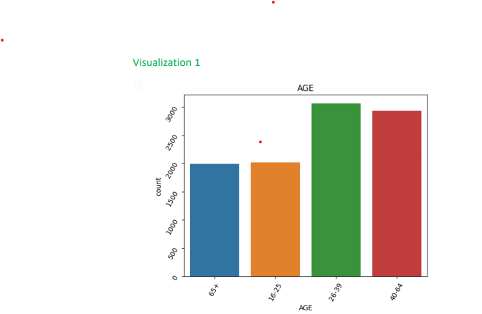

Slide 7
Age
Finding:
The majority of customers fall into the '26-39' and '40-64' age groups.
Implication for Stakeholder (Insurance Company):
Tailoring insurance offers to these age demographics can increase customer engagement and reduce claim frequency.

Slide 8
Credit score vs outcome
Finding:
Customers with lower credit scores are more likely to file claims.
Implication for Stakeholder (Underwriting Team):
Consider credit score as a significant risk factor for insurance premiums and coverage. Leads to more accurate risk assessments and optimized pricing.

Slide 9
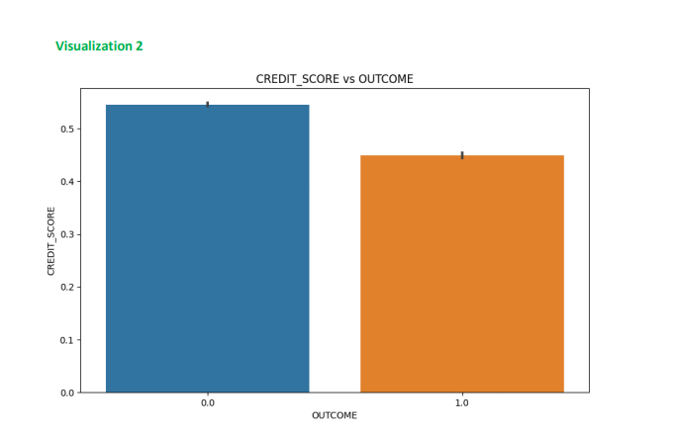

Slide 10
Final Recommendations
Recommendations for Insurance Company:
Targeted Marketing:
Tailor marketing campaigns for '26-39' and '40-64' age groups.
Underwriting Guidelines:
Incorporate credit scores as a key risk factor.
Claim Prevention:
Engage high-risk customers with preventive measures.
Continuous Monitoring:
Regularly update and retrain the predictive model with new data.

Slide 11
Conclusion:
Implementing these recommendations will enhance risk management, refine customer targeting, and improve overall business performance for the Insurance Company.

Slide 12
Questions

